Slide 1
Respiratory System
Krishna Bastola
B.Sc. MLT, M.Sc.

Slide 2
Introduction
The complex of organs and tissue which are necessary to exchange blood carbondioxide (CO₂) with air oxygen (O₂) is called the respiratory system. It consists of:
structures, which function as ducts, and which together are called the conductive portion of the respiratory system.
structures which form the respiratory portion of the respiratory system, in which the exchange of CO₂ and O₂ is occurring, and
the parts of the thoracic musculo-skeletal apparatus and specialisations of the lung which allow the movement of air through the respiratory system - the ventilating mechanism.

Slide 3
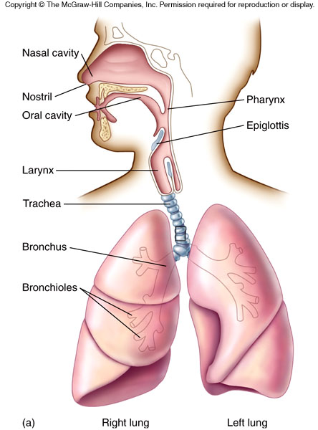
Introduction
Most common entry point for infections
Upper respiratory tract includes:
nose, nasal cavity, sinuses, mouth, throat
Lower respiratory tract includes:
Trachea, bronchi, bronchioles, and alveoli in the lungs
Fig: Overview of respiratory system

Slide 4
Upper Respiratory Tract Infections
Tonsillitis (mostly bacterial)
Otitis media (mostly bacterial)
Epiglottitis
Laryngitis
Laryngotrachiobronchitis

Slide 5
Nonspecific protective mechanisms in URT keeps lungs sterile…how ?
“Mechanisms that prevent foreign objects or organisms from entering the bronchial tree.”
Nasal hair, convoluted passages, mucus lining of nasal turbinate.
Secretory IgA
Nonspecific antibacterial substances (lysozyme) in respiratory secretions.
Cilia and mucus lining of trachea.
Reflexes: coughing, sneezing, swallowing.
Normal URT flora (help to prevent Colonization of the URT by pathogenic microorganisms)
Suppose a particle could escape and enter the alveoli …..?
The alveolar macrophages ingest them and carry them to lymphatics.
Notes:
Convoluted: twisted

Slide 6
Respiratory Infection
Infections of the respiratory tract are described according to anatomical area of involvement.
The upper respiratory tract consist of:
Pharynx, larynx, and upper part of the trachea.
The lower respiratory tract consist of:
Lower trachea, bronchi, bronchioles, and the alveoli.

Slide 7
Bacterial URT infections
Basically, all microorganisms must first come into contact with mucosal epithelium of URT and adhere to it, colonize, and multiply locally.
Very few organisms shown to cause true disease here, although a large number of different bacteria could be isolated from URT specimen, such as:
S. pyogenes
Streptococcal groups: B, C, G, non-hemolytic, have been reported.
Corynebacterium diphtheriae.
Arcanobacterium haemolyticum
Neisseria gonorrhoeae: exudative pharyngitis.

Slide 8
Viral Pathogens
Rhinoviruses
Adenoviruses
Respiratory Syncytial virus (RSV).
Influenza virus .
Parainfluenza virus.
Coronaviruses
Coxsackiviruses.
Cytomegalovirus
Epstein-Barr virus
Herpes simplex-1

Slide 9
Selected Bacterial Infections of Respiratory tract
Pharyngitis
Group A Strep - Streptococcus pyogenes
(Many viruses also cause this)
Pneumonia - Streptococcus pneumoniae
Diphtheria - Corynebacterium diphtheriae
Tuberculosis - Mycobacterium tuberculosis
Whooping cough - Bordetella pertussis

Slide 10
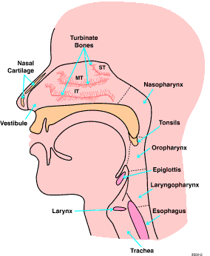
Definition
Upper Respiratory Tract Infections
Inflammation of the respiratory mucosa from the nose to the lower respiratory tree, not including the alveoli.

Slide 11
Pharyngitis
Hemolytic streptococci infection of the upper air way (throat).
Clinical manifestations
Headache
Abdominal pain
Anorexia
Fever
The tonsils and pharynx may be inflamed and covered with exudates.
Swallowing difficult

Slide 12
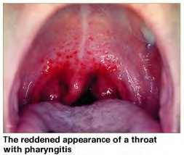
Pharyngitis

Slide 13
Acute pharyngitis
Most cases are viral
Most important bacterial cause is Streptococcus pyogenes (15-20%), other bacteria: Mycoplasma pneumoniae, Chlamydia pneumoniae, and Neisseria gonorrhoeae cause bacterial pharyngitis
Presents with sore or scratchy throat
In severe bacterial cases there may be fever, headache

Slide 14
Sore Throat Complications
Complications such as rheumatic fever (inflammation of connective tissue and joint pain), scarlet fever (fever with body rash), tonsil abscess, and glomerulonephritis (kidney disease) can result from untreated streptococcal infection.
Severe pharyngitis associated with Corynebacterium diphtheriae and infectious mononucleosis (glandular fever), can obstruct the airway and cause lower respiratory problems (e.g., pneumonia).
Longstanding infection of the tonsils (tonsillitis) can result in peritonsillar abscess, which affects the connective tissue of the tonsil.
Notes:
Mononucleosis: An acute viral infection sore throat, swollen lymph glands and fever. Also known as glandular fever, infectious mononucleosis is caused by members of the herpes group of viruses – the EPSTEIN BARR VIRUS and CYTOMEGALOVIRUS (CMV).

Slide 15
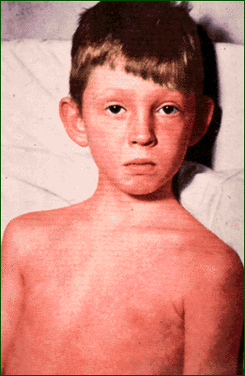
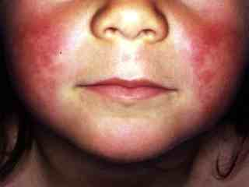
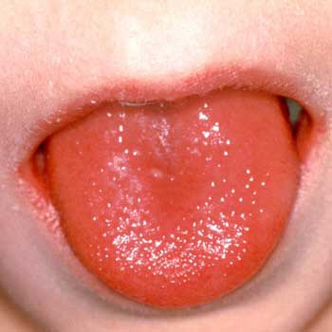
Scarlet Fever

Slide 16
Diphtheria

Slide 17
Diphtheria
Caused by Corynebacterium diphtheriae: slow onset, then marked toxicity
Aerobic Gram +ve bacillus
Transmitted by droplets or fomites
Infects the upper respiratory tract
Begins with severe sore throat, low-grade fever and swollen lymph nodes or with skin rash, 1-6 days after infection
Toxin inhibits protein synthesis of cells to which it binds
Destroyed cells and WBCs form "pseudomembrane" which blocks airways

Slide 18
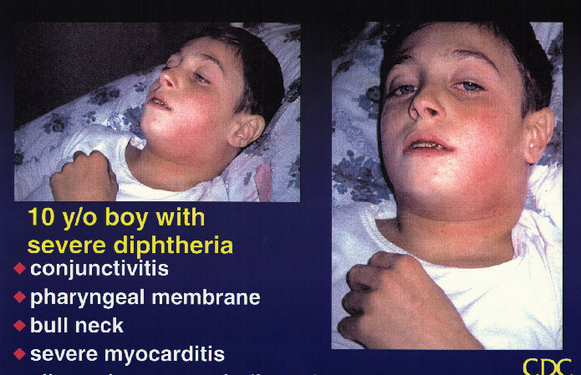
Diphtheria

Slide 19
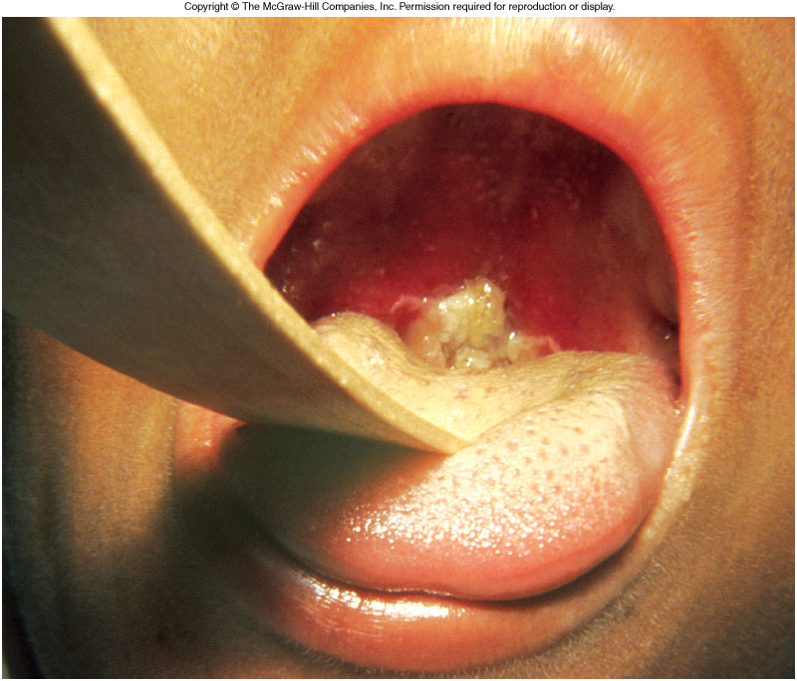
Diphtheria

Slide 20
Tonsillitis

Slide 21
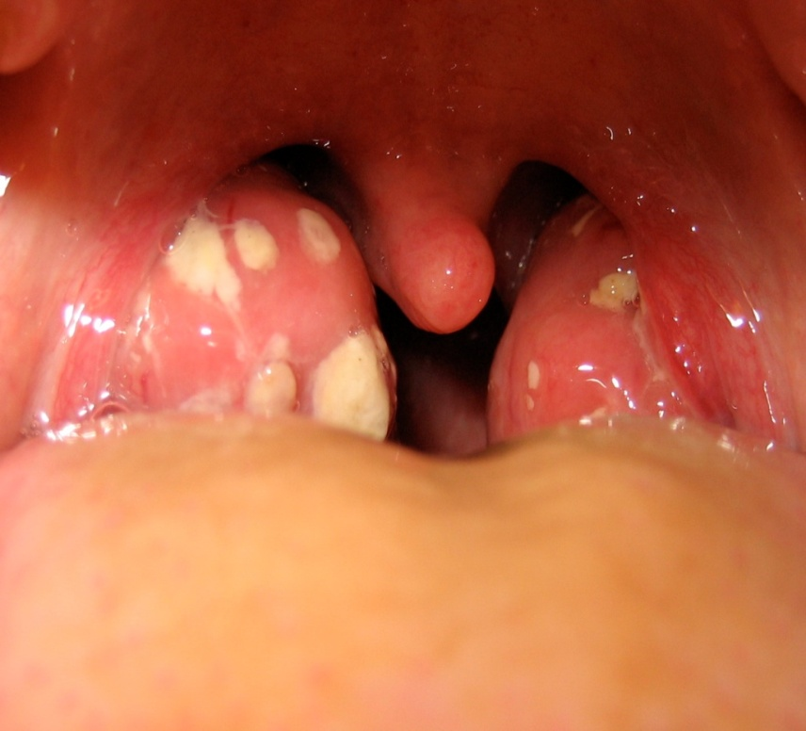
Tonsillitis
Tonsils are masses of lymphoid tissue
located in the pharyngeal cavity.
Etiology
Tonsillitis often occurs with Pharyngitis.
Viral or bacterial
Common cold viruses (adenovirus, rhinovirus, influenza, coronavirus, respiratory syncytial virus).
Common bacterial cause is Group A β-hemolytic streptococcus (GABHS), which causes strep throat.
Less common bacterial causes include: Staphylococcus aureus, Streptococcus pneumoniae, Mycoplasma pneumoniae, Chlamydia pneumoniae, pertussis, Fusobacterium, diphtheria, syphilis, and gonorrhea

Slide 22
Tonsillitis
Clinical manifestations
Difficulty swallowing and breathing.
The child breathes through the mouth.
Symptoms of tonsillitis include sore throat and fever
Therapeutic management
Tonsillectomy
Adenoidectomy

Slide 23
Croup (acute spasmodic laryngitis)
Definition
A severe inflammation and obstruction of the upper airway (larynx) and the main air passages (trachea and bronchi).
Causes
Viral (RSV, Influenza virus)
Bacteria (pertussis, diphtheria, mycoplasma).
Symptoms/Complications
Rhinorrhea, sore throat, mild cough, fever
Respiratory insufficiency, cyanosis

Slide 24
Lower Respiratory Tract Infections

Slide 25
Lower respiratory infections: anatomic classification
Tracheitis; bronchitis; tracheobronchitis
Bronchiolitis
Bronchopneumonia
Segmental pneumonia
Lobar pneumonia
Interstitial pneumonia

Slide 26
Acute bronchitis (“chest cold”)
Usually of viral etiology and bacteria
A common cause for overuse of antibiotics
Bordetella pertussis (whooping cough) sometimes causes acute bronchitis in adults
Mycoplasma pneumoniae and Chlamydia pneumoniae may play a role
Characterised by coughing, production of mucopurulent sputum, and narrowing of the bronchi due to spasmodic contraction

Slide 27
Bronchiectasis
Abnormal dilatation or widening of bronchi with chronic productive cough.
Pus may form in the widened bronchus so that the patient coughs up purulent sputum, which may contain blood.
Can be due to cystic fibrosis (disorder of the mucus-secreting glands of the lungs) (associated with S. aureus and Pseudomonas species)
Or from obstruction, either by an inhaled foreign body or by a growth (including cancer)

Slide 28
Pneumonia

Slide 29
Pneumonia
6th leading cause of death in U.S.A. and in world
About 3 million cases per year; >500,000 hospital admissions
About 50% of cases and the majority of deaths are due to bacteria
Precise diagnosis is usually desirable but difficult to obtain

Slide 30
Pneumonia
Pneumonia is defined as acute inflammation of the lung parenchyma distal to the terminal bronchioles (consisting of the respiratory bronchiole, alveolar ducts, alveolar sacs and alveoli).
The terms ‘pneumonia’ and ‘pneumonitis’ are often used synonymously for inflammation of the lungs, while ‘consolidation’ (meaning; solidification and fluid filled alveoli produced by inflamed tissue) is the term used for gross and radiologic appearance of the lungs in pneumonia.
An acute respiratory illness of the lung parenchyma associated with recently developed radiological pulmonary shadowing which may be segmental, lobar or multilobar.

Slide 31
Types of Pneumonia
One of the classification divides pneumonia into:
Primary (community-acquired)
Typical pneumonia
Lobar pneumonia
Bronchopneumonia
Atypical pneumonia
Secondary
Aspiration pneumonia
Nosocomial (hospital-acquired) pneumonia
Pneumonia in immunosuppression
Others:
Chronic pneumonia
Necrotizing pneumonia/Supporative pneumonia/Lung Abscess

Slide 32
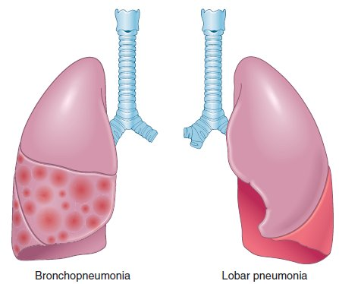
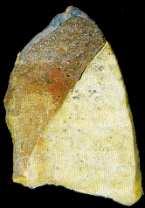

Slide 33
Pathogens in pneumonia
Strep. pneumoniae (pneumococcus)
Mycoplasma pneumoniae
H. influenzae
Influenza
Chicken pox – in adult smokers
Legionella
Coxiella burnetti
Chlamydia psittaci

Slide 34
Pathogens in pneumonia
Streptococcus pneumoniae the most common cause of community-acquired pneumonia requiring hospitalization
Haemophilus influenzae and Moraxella catarrhalis are increasing in frequency
Legionella species and Chlamydia pneumoniae have emerged
Pneumocystis carinii (HIV disease)

Slide 35
“Typical” versus “atypical” pneumonia
“Typical” (virulent bacteria): sudden onset; productive cough with purulent sputum; pleuritic chest pain; impressive or notable physical findings; leukocytosis or leukopenia
“Atypical” (viral, Mycoplasma pneumoniae, others): gradual onset, nonproductive cough; substernal chest pain; unimpressive physical exam; white blood count normal

Slide 36
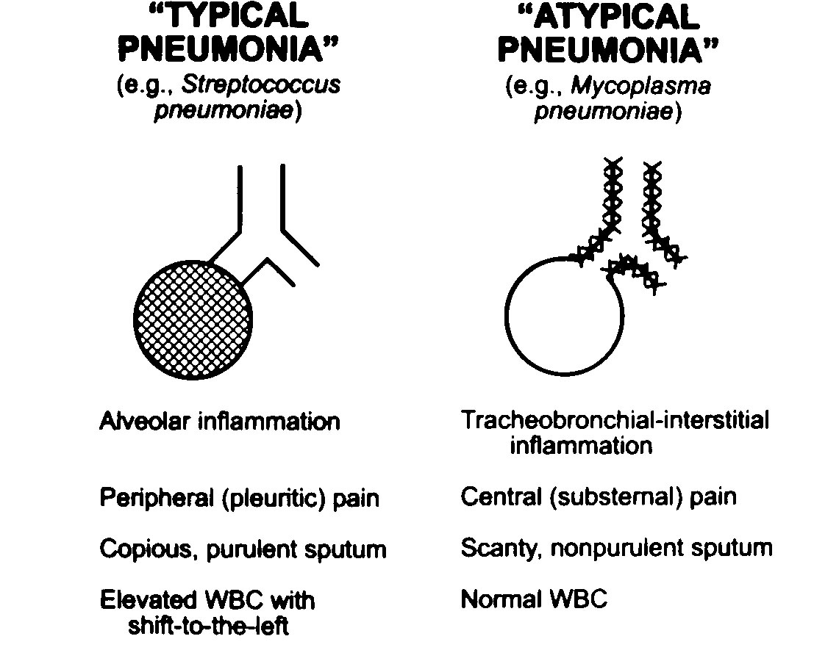
“Typical” versus “atypical” pneumonia

Slide 37
Pneumonia
Epidemiology:
Classified as community-acquired or nosocomial (hospital acquired)
Community-acquired pneumonia is further subdivided into typical and atypical.
Typical community-acquired pneumonia
Epidemiology
Majority are caused by bacterial pathogens
Most often due to Streptococcus pneumoniae
Pathogenesis
Inhalation of aerosol from an infected patients
Aspiration of nasopharyngeal flora while sleeping

Slide 38
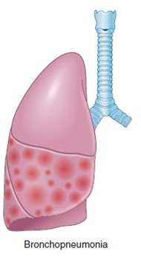
Pneumonia
Bronchopneumonia
Begins as an acute bronchitis and spreads locally into lungs
Usually involves the lower lobes or right middle lobe
Lung has patchy areas of consolidation
- Micro abscesses are present in the area of consolidation

Slide 39
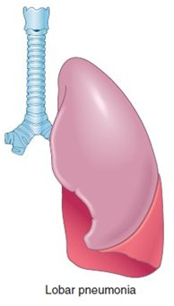
Pneumonia
Lobar pneumonia
Complete or almost complete consolidation of a lobe of lung
Complications
Lung abscesses, empyema (pus in the pleural cavity)
Sepsis or poisoning

Slide 40
Pneumonia
Four classic phases
Congestion: affected lobe(s) are heavy, red, boggy, edema and many bacteria in the alveoli
Red hapatization: liver-like consistency; alveolar space are packed with neutrophils, red cells and fibrins
Grey hapatization: dry, grey and firm due to degradation of red blood cells
Resolution: healing; exudates and granular semi-fluid debris are resorbed and ingested by macrophages, or coughed up

Slide 41
Pneumonia
Clinical findings:
Sudden onset of high fever with productive cough
Signs of consolidation (alveolar exudate)
Dullness to percussion (beating)
Increased vocal tactile fremitus (Tremors or vibrations; sound is transmitted well through alveolar consolidation)
Inspiratory crackles (short, dry, sharp sound; air moving through exudate in the alveoli)
Chest radiography (gold standard screen):
Patchy infiltrates (bronchopneumonia or lobar consolidation)
Laboratory findings:
Positive gram stain; neutrophilic leucocytosis

Slide 42
Pneumonia
Atypical community-acquired pneumonia
Epidemiology
Usually caused by Mycoplasma pneumoniae
Other pathogens:
Chlamydia pneumoniae, Chlamydia trachomatis (newborns), viruses (respiratory syncytial virus, influenza virus, adenovirus)
Pathogenesis
Contracted by inhalation (droplet infection)
Alveolar spaces usually free of exudates

Slide 43
Pneumonia
Atypical community-acquired pneumonia
Clinical findings:
Insidious onset, low-grade fever, nonproductive cough
Flu-like symptoms
Pharyngitis, laryngitis, myalgias (pain in muscle), headache
No sign of consolidation
Nosocomial pneumonia
Epidemiology/Risk Factor
Severe underlying disease
Antibiotic therapy, immunosuppression
Respirators (most common source of infection)
Pathogens
Gram negative bacteria: Pseudomonas aeruginosa, E. coli
Gram positive bacteria: Staphylococcus aureus

Slide 44
Pneumonia
Pneumonia in immunocompromised hosts
Complication of AIDS and bone marrow transplantation
Common opportunistic infections:
Cytomegalovirus
Pneumocystis jiroveci
Aspergillus fumigatus

Slide 45
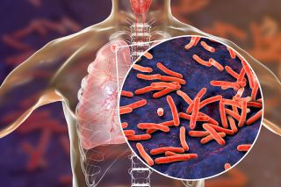
Tuberculosis

Slide 46
Tuberculosis
It is a serious disease caused by inhalation of aerosolized bacilli of mycobacterium tuberculi.
Tubercle bacillus or Koch’s bacillus (named after discovery of the organism by Robert Koch in 1882) called Mycobacterium tuberculosis causes tuberculosis in the lungs and other tissues of the human body.
The organism is a strict aerobe and thrives best in tissues with high oxygen tension such as in the apex of the lung.

Slide 47
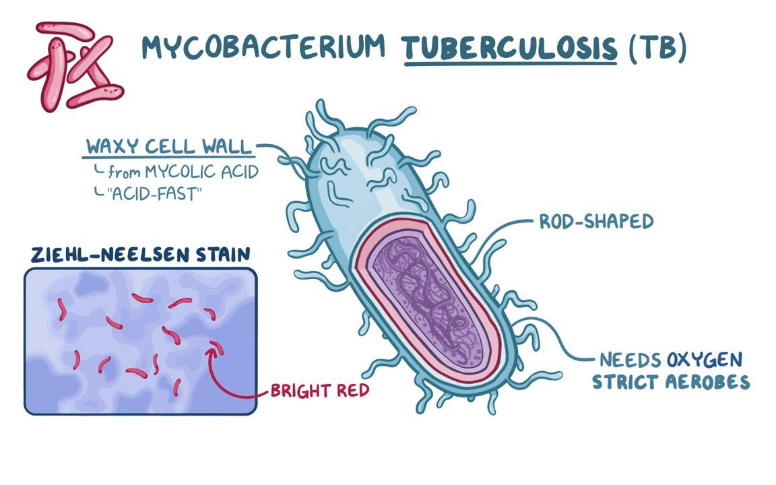
Tuberculosis
Their cell wall contains thick, complex lipid (mycolic acid) which makes them resistant to commonly used disinfectants and laboratory staining reagents.
But once stained, they resist decolorization with acid solution and alcohol, so called as acid-fast bacilli (AFB).
Gram + ve but difficult to stain, stained by acid-fast stain or Ziehl-Neelsen (ZN) stain.

Slide 48
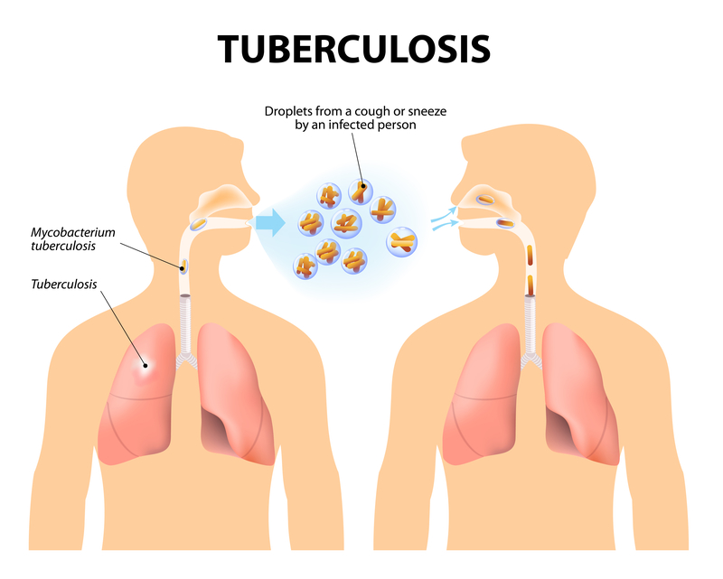
Tuberculosis
MODE OF TRANSMISSION:
Human beings acquire infection with tubercle bacilli by one of the following routes:
Inhalation of organisms present in fresh cough droplets or in dried sputum from an open case of pulmonary tuberculosis.

Slide 49
Tuberculosis
MODE OF TRANSMISSION:
Human beings acquire infection with tubercle bacilli by one of the following routes:
Ingestion of the organisms leads to development of tonsillar or intestinal tuberculosis. This mode of infection of human tubercle bacilli is from self-swallowing of infected sputum of an open case of pulmonary tuberculosis, or ingestion of bovine tubercle bacilli from milk of diseased cows.
Inoculation of the organisms into the skin may rarely occur from infected postmortem tissue.
Transplacental route results in development of congenital tuberculosis in foetus from infected mother and is a rare mode of transmission.

Slide 50
Tuberculosis
The act of coughing, sneezing and speaking release a large number of droplets containing as many as 3000 infectious airborne droplets nuclei per cough.
The droplet nucleus is small, measures 5 µm or less, and may contain approximately 1-10 tubercle bacilli.
Theoretically, although a single tubercle bacillus may cause disease, in practice 5-200 inhaled bacilli are essential for infection.
These droplets by virtue of their small size remain suspended in the air for a very long period of time.

Slide 51
Tuberculosis
SPREAD OF TUBERCULOSIS
The disease spreads in the body by various routes:
Local spread:
This takes place by macrophages carrying the bacilli into the surrounding tissues.
Lymphatic spread:
Tuberculosis is primarily an infection of lymphoid tissues. The bacilli may pass into lymphoid follicles of pharynx, bronchi, intestines or regional lymph nodes resulting in regional tuberculous lymphadenitis which is typical of childhood infections. Primary complex is primary focus with lymphangitis and lymphadenitis.
Haematogenous spread:
This occurs either as a result of tuberculous bacillaemia because of the drainage of lymphatics into the venous system or due to caseous material escaping through ulcerated wall of a vein. This produces millet seed-sized lesions in different organs of the body like lungs, liver, kidneys, bones and other tissues and is known as miliary tuberculosis.

Slide 52
Tuberculosis
SPREAD OF TUBERCULOSIS
The disease spreads in the body by various routes:
By the natural passages:
Infection may spread from:
lung lesions into pleura (tuberculous pleurisy);
transbronchial spread into the adjacent lung segments;
tuberculous salpingitis into peritoneal cavity (tuberculous peritonitis);
infected sputum into larynx (tuberculous laryngitis);
swallowing of infected sputum (ileocaecal tuberculosis); and
renal lesions into ureter and down to trigone of bladder.

Slide 53
Tuberculosis
Types:
Mainly two types:
Pulmonary tuberculosis
Primary
Secondary
Extrapulmonary tuberculosis
Pulmonary tuberculosis:
It is a contagious infection that involves the lungs. Infection is caused by Mycobacterium tuberculosis bacteria.

Slide 54
Tuberculosis
Pathophysiology:
Inhalation of Mycobacterium bacteria
Body immune system responds by initiating an inflammatory response
Inhaled bacteria is phagocytosed by alveolar macrophages
Tissue reaction results in accumulation of exudates in alveoli
causing bronchopneumonia
Inflammatory process and cellular reaction produces a small white nodules
called primary tubercles

Slide 55
Tuberculosis
Pathophysiology:
New tissue masses of live dead bacilli are surrounded by macrophages,
forms a protective wall
Transformed to fibrous tissue centre of which is called
Ghon’s tubercle (granulomatous inflammation)
Material becomes necrotic, forming a cheesy mass, may become calcified
to collagenous scar
Ghon’s tubercle ulcerate releasing cheesy materials
Becomes airborne and spread slowly downward to other parts of the lungs

Slide 56
Tuberculosis
Clinical Features:
Productive cough
Hemoptysis
Excessive sweating, especially at night
Fever
Fatigue
Weight loss
Chest pain
Anorexia
Breathing difficulty
Wheezing/breathless
Enlarged or tender lymph nodes in the neck or other
Fluid around the lung (pleural effusion)
Clubbing of the finger or toes

Slide 57
Tuberculosis
Primary tuberculosis:
It represents the initial exposure or infection caused by M. tuberculosis in an infected host.
The infection of an individual who has not been previously infected or immunised is called primary tuberculosis or Ghon’s complex or childhood tuberculosis.
Primary complex or Ghon’s complex is the lesion produced in the tissue of portal of entry with foci in the draining lymphatic vessels and lymph nodes.
The most commonly involved tissues for primary complex are lungs and hilar lymph nodes.

Slide 58
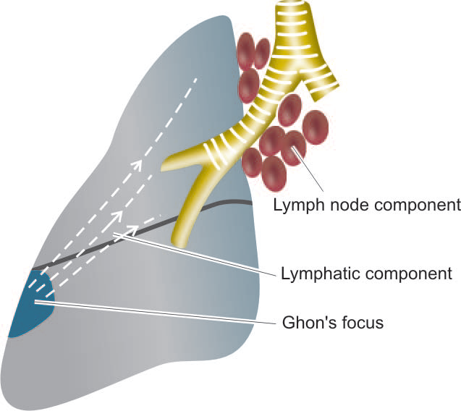
Tuberculosis
Primary tuberculosis:
Fig: The primary complex composed of 3 components: Ghon’s focus, draining lymphatics, and hilar lymph nodes.

Slide 59
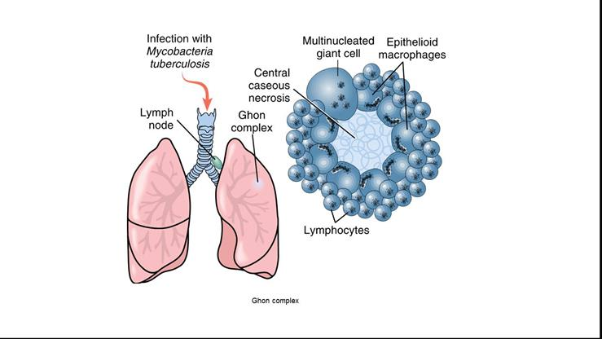
Tuberculosis
Ghon’s tubercle (granulomatous inflammation)

Slide 60
Tuberculosis
Secondary tuberculosis:
It is caused either by reactivation of latent infection or by exogenous reinfection (fresh dose of reinfection by the tubercle bacilli).
Reactivation of primary lesion occurs more commonly in patients with decreased immunity, HIV patients, and in elderly patients.
Secondary tuberculosis occurs most commonly in lungs in the region of apex (high oxygen tension).
Other sites and tissues which can be involved are tonsils, pharynx, larynx, small intestine and skin.

Slide 61
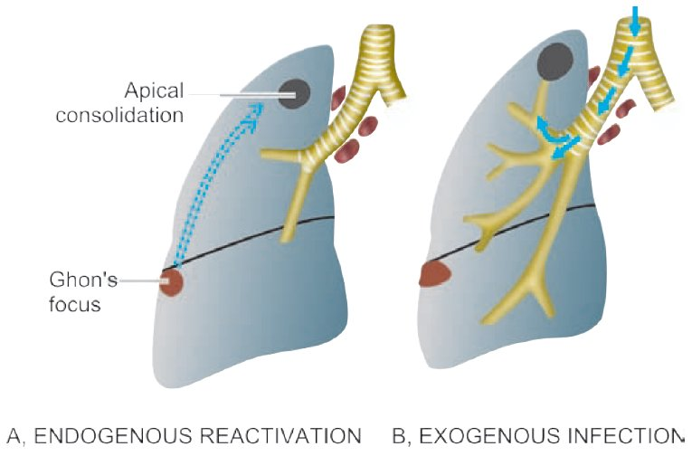
Tuberculosis
Fig: Progressive secondary tuberculosis. A, Endogenous infection from reactivation of dormant primary complex. B, Exogenous infection from fresh dose of tubercle bacilli.

Slide 62
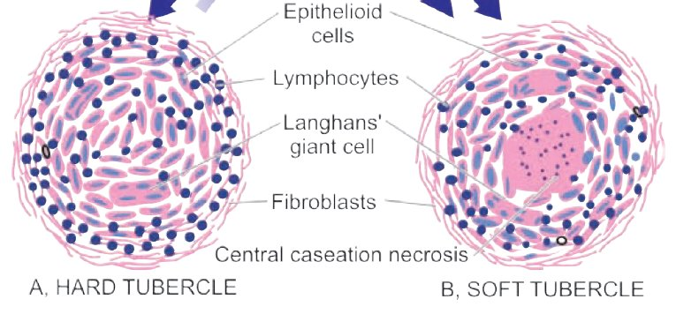
Tuberculosis
Tubercle:
Key pathology in tuberculosis
Avascular granulomatous condition
Composed of a peripheral zones of lymphocytes and fibroblasts and a central zone consisting of Langhans’ giant cells with or without caseation (cheese-like mass).

Slide 63
Tuberculosis
Extrapulmonary tuberculosis:
Usually occurs as a result of spread of the bacilli through blood circulation during the initial stage of multiplication at the site of primary infection, i.e., lung.
Depending on the site of infection, it may be:
Genitourinary tuberculosis
Tubercular meningitis
Gastrointestinal tuberculosis
Skeletal tuberculosis
Tubercular lymphadenitis, and others

Slide 64
Lung abscess

Slide 65
Lung abscess
LUNG ABSCESS
Lung abscess is a localised area of necrosis of lung tissue with suppuration.
It is of 2 types:
Primary lung abscess that develops in an otherwise normal lung. The commonest cause is aspiration of infected material.
Secondary lung abscess that develops as a complication of some other disease of the lung or from another site.

Slide 66
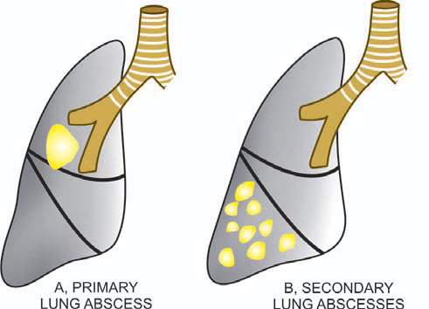
Lung abscess
Fig: Common locations of lung abscess.
A, Primary lung abscess—mostly single, large, commonly due to aspiration, located most frequently in the lower part of right upper lobe or apex of right lower lobe.
B, Secondary lung abscesses—mostly multiple, small, most commonly post-pneumonic or following septic embolism.

Slide 67
Lung abscess
ETIOPATHOGENESIS:
The microorganisms commonly isolated from the lungs in lung abscess are streptococci, staphylococci and various gram-negative organisms. These are introduced into the lungs from one of the following mechanisms:
Aspiration of infected foreign material:
A number of foreign materials such as food, decaying teeth, gastric contents, severely infected gingivae and teeth, and necrotic tissue from lesions in the mouth, upper respiratory tract or nasopharynx may be aspirated. This occurs particularly in favorable circumstances such as during sleep, unconsciousness, anaesthesia, general debility and acute alcoholism.
Preceding bacterial infection:
Preceding bronchopneumonia in a debilitated patient may develop into lung abscess. Other infective conditions like tuberculosis, bronchiectasis and mycotic infections may occasionally result in formation of lung abscess.

Slide 68
Lung abscess
ETIOPATHOGENESIS:
Bronchial obstruction:
An abscess may form distal to an obstructed bronchus such as from bronchial tumour or from impacted foreign body.
Septic embolism:
Infected emboli originating from pyaemia, thrombophlebitis or from vegetative bacterial endocarditis may be disseminated in the venous circulation and reach the right side of the heart from where they are lodged in the lung and result in multiple abscesses.
Miscellaneous:
Rarely lung abscesses may occur from following causes:
Infection in pulmonary infarcts.
Amoebic abscesses due to infection with Entamoeba histolytica.
Trauma to the lungs.

Slide 69
Lung abscess
CLINICAL FEATURES:
Fever
Malaise
Loss of weight
Cough
Purulent expectoration
Haemoptysis in half the cases
Clubbing of the fingers and toes
Secondary amyloidosis may occur in chronic long-standing cases.

Slide 70
Lung abscess
Grossly,
Abscesses may be of variable size from a few millimeters to large cavities, 5 to 6 cm in diameter.
The cavity often contains exudate.
The abscess may becomes chronic and develops fibrous wall.
Histologically,
The characteristic feature is the destruction of lung parenchyma with suppurative exudate in the lung cavity.
The cavity is initially surrounded by acute inflammation in the wall but later there is replacement by chronic inflammatory cell infiltrate composed of lymphocytes, plasma cells and macrophages.
In more chronic cases, there is considerable fibroblastic proliferation forming a fibrocollagenic wall.

Slide 71
Chronic Obstructive Pulmonary Disease (COPD)

Slide 72
Chronic Obstructive Pulmonary Disease (COPD)
COPD is a lung disease characterised by elastic tissue destruction resulting in a chronic obstruction of lung air flow that interferes with normal breathing and isn’t fully reversible.
This is a term encompassing chronic BRONCHITIS, EMPHYSEMA, and chronic ASTHMA where the airflow into the lungs is obstructed.
In COPD, less air flows in and out because of:
Loosing of elastic quality by airways and air sacs
Walls between many air sacs are destroyed
Walls of airways become thick and inflamed

Slide 73
Chronic Obstructive Pulmonary Disease (COPD)
CHRONIC BRONCHITIS:
Chronic bronchitis is a pathological condition characterised by chronic productive cough for at least three months in two successive years.
It is a progressive inflammatory disease resulting from prolonged irritation of the bronchial epithelium.
One or more of the following predisposing factors are usually present:
acute bronchitis commonly caused by Haemophilus influenzae or Streptococcus pneumoniae
cigarette smoking
atmospheric pollutants, e.g. motor vehicle exhaust fumes, industrial chemicals, sulphur dioxide, urban fog
previous episodes of acute bronchitis.

Slide 74
Chronic Obstructive Pulmonary Disease (COPD)
CHRONIC BRONCHITIS:
It develops mostly in middle-aged men who are chronic heavy smokers and may have a familial predisposition.
The changes occurring in the bronchi include:
increase in the number and size of mucous glands
oedema and other inflammatory changes
reduction in the number and function of ciliated cells
narrowing of bronchioles due to fibrosis of the airways

Slide 75
Chronic Obstructive Pulmonary Disease (COPD)
Pathophysiology of Chronic Bronchitis:
Predisposing factors
Age
Genetics
Exposure to smoke
Casual factors
Smoking
Contributing factors
Occupational exposure
Causes irritation of airways
Irritation leads to hypertrophy of mucus secreting glands and
increases secretion of goblet cells
Increases mucus and decreases ciliated cells

Slide 76
Chronic Obstructive Pulmonary Disease (COPD)
Pathophysiology of Chronic Bronchitis:
Reduce mucus clearance
Results in accumulation of secretion and plugs the airways
Causes persistent cough with phlegm (mucus) indicating chronic bronchitis
Fig: Flowchart of Pathophysiology of Chronic Bronchitis

Slide 77
Chronic Obstructive Pulmonary Disease (COPD)
EMPHYSEMA:
It is a chronic respiratory disease in which over inflation of the alveoli or air sac causes a decrease in respiratory function and dyspnea (shortness of breath).
Destruction of alveolar septa resulting in enlarged air spaces and a loss of elastic recoil.
Predisposing factors include:
cigarette smoking, believed to promote the release of proteolytic enzymes from mast cells and basophils in the lungs
acute inflammation of bronchi and lungs
increased pressure caused by coughing which stretches the already damaged structures
congenital deficiency of an antiproteolytic enzyme, α1-antitrypsin, leading to destruction of supporting elastic tissue in the lungs.

Slide 78
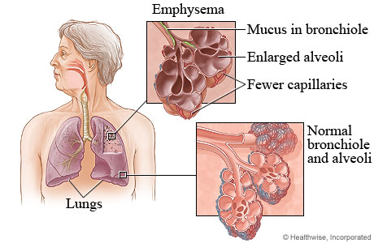
Chronic Obstructive Pulmonary Disease (COPD)
EMPHYSEMA:
Other risk factors:
Exposure to tobacco smoke
People with asthma who smoke
Occupational exposure to dusts and chemicals
Age
Genetics
Causes:
Smoking
Exposure to gases and fumes
Passive smokers
Fire work
Occupational exposure
α1-antitrypsin deficiency

Slide 79
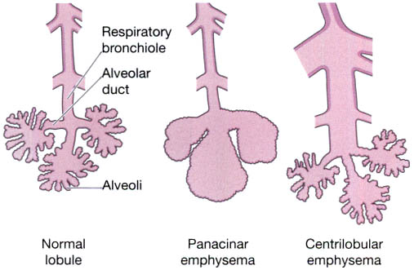
Chronic Obstructive Pulmonary Disease (COPD)
EMPHYSEMA:
Gross:
Overinflated, enlarged lungs
Enlarged, grossly visible air sacs
Formation of apical blebs and bullae
Clinical findings:
Progressive dyspnea
Pursing of lips and use of
accessory muscle to breathe
Barrel chest
Weight loss

Slide 80
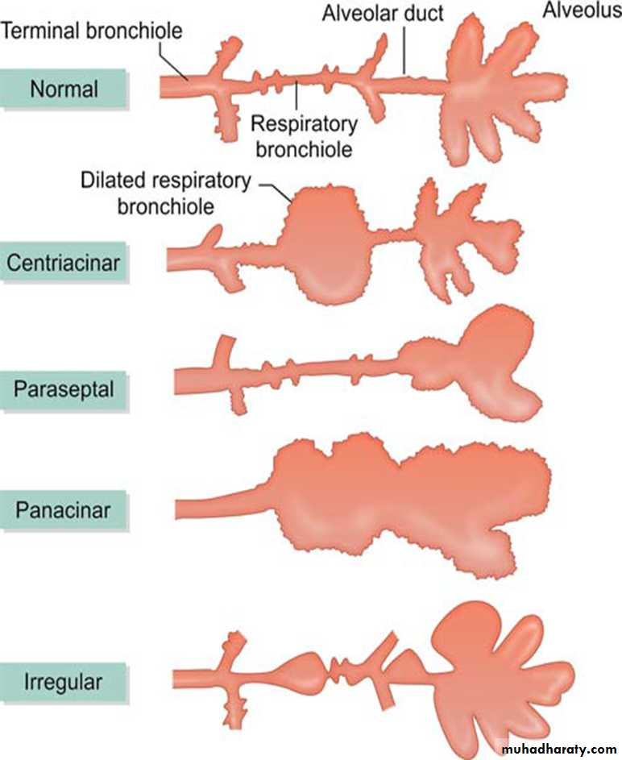
Chronic Obstructive Pulmonary Disease (COPD)
Centriacinar begins in the respiratory bronchioles and spreads peripherally.
Paraseptal emphysema localizes around the septae of the lungs or pleura, often associated with inflammatory processes.
Panacinar destroys the alveolar tissue and is associated with α1-antitrypsin deficiency.

Slide 81
Chronic Obstructive Pulmonary Disease (COPD)
Pathophysiology of Emphysema:
Predisposing factors
Age
Genetics
Exposure to smoke
Casual factors
Smoking
Contributing factors
Occupational exposure
Leads to destruction of the wall of the alveoli
Results in decreased alveolar surface area (in contact with pulmonary capillaries)
Increases dead space as a result of which cessation of gaseous exchange takes place

Slide 82
Chronic Obstructive Pulmonary Disease (COPD)
Pathophysiology of Emphysema:
Results in impaired diffusion of oxygen and impair exchange of O2 and CO2
Leads to hypoxia with evidence of permanent dilation of elastic tissue
Develops signs and symptoms of emphysema
Fig: Flowchart of Pathophysiology of Emphysema
So, in this way, either chronic bronchitis only or emphysema only or sometimes both combinely leads to chronic obstructive pulmonary disease (COPD).

Slide 83
Chronic Obstructive Pulmonary Disease (COPD)
Clinical features:
On inspection:
Breathlessness
Productive cough
Pursed lip breathing
Distended neck vein
Dyspnea (shortness of breathe)
Cyanosis (bluish skin)
Frequent infection
On palpation:
Enlarged pulsating liver
Larged barrel shaped chest
Low, flat diaphragm

Slide 84
Chronic Obstructive Pulmonary Disease (COPD)
Clinical features:
On percussion:
Abnormal breath sounds
On auscultation:
Wheezing sound
Diminished breath sound
Others:
Fever
Headache

Slide 85
Chronic Obstructive Pulmonary Disease (COPD)
ASTHMA

Slide 86
Chronic Obstructive Pulmonary Disease (COPD)
ASTHMA:
It is a chronic inflammatory disease of the airways characterised by hyperresponsiveness of the airways, mucosal edema, mucus production and bronchospasm (muscular contraction of the bronchi causing narrowing), resulting in intermittent airways obstruction.
It is characterised by chronic inflammation and increased airways hyperresponsiveness leading to symptoms of wheeze, cough, chest tightness and dyspnea.
It is characterised functionally by the presence of airflow obstruction which is variable over short period of time, or is reversible with treatment.

Slide 87
Chronic Obstructive Pulmonary Disease (COPD)
Pathogenesis:
Etiology:
Allergens and airway irritants (e.g. grass, weed pollens, mold, dust or animals), pollutants, cold, heat, strong odors, smoke, perfumes)
Exercise
Stress or emotional upset, rhinosinusitis, medications
Viral respiratory tract infection and gastro-esophageal reflux.

Slide 88
Chronic Obstructive Pulmonary Disease (COPD)
Pathophysiology of Asthma :
Inhalation of allergens (causative factors)
TH2 reaction against environmental antigens
TH2 cells produce cytokines (IL-4, IL-5, IL-13)
IL-4 stimulates IgE production
IL-5 activates eosinophils
IL-13 stimulates mucus production

Slide 89
Chronic Obstructive Pulmonary Disease (COPD)
Pathophysiology of Asthma :
Activation of epithelial cells
Chemokines are produced that promote recruitment of more TH2 cells
and eosinophils as well as other leukocytes
Amplifies the inflammatory reaction
Structural changes in bronchial wall referred to as “airway remodeling”
Hypertrophy of bronchial smooth muscle and deposition of subepithelial collagen
Fig: Flowchart of Pathophysiology of Asthma

Slide 90
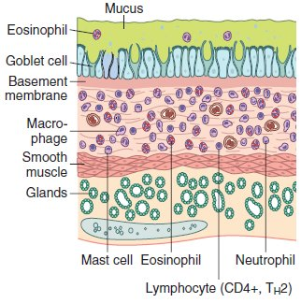
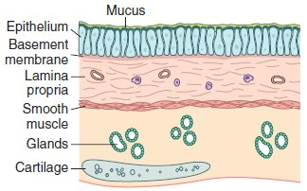
Chronic Obstructive Pulmonary Disease (COPD)
Normal
Bronchial Asthma
Fig: Comparison of a normal bronchus with that in a patient with asthma. Note the accumulation of mucus in the bronchial lumen resulting from an increase in the number of mucus-secreting goblet cells in the mucosa and hypertrophy of submucosal glands. In addition, there is intense chronic inflammation due to recruitment of eosinophils, macrophages, and other inflammatory cells. Basement membrane underlying the mucosal epithelium is thickened, and smooth muscle cells exhibit hypertrophy and hyperplasia.

Slide 91
Chronic Obstructive Pulmonary Disease (COPD)
Clinical features of Asthma:
Recurrent episodes of wheezing, chest tightness, breathlessness and cough
Asthma attacks frequently occur at night or in the early morning
Expiration requires effort and becomes prolonged
As exacerbation progresses, central cyanosis (bluish) secondary to severe hypoxia may occur
Additional symptoms, such as diaphoresis (sweating), tachycardia, and a widened pulse pressure may occur
Exercise-induced asthma: maximal symptoms during exercise
A severe, continuous reaction, status asthmaticus (repeated attacks of asthma), may occur
Eczema (dermatitis), rashes and temporary edema are allergic reactions that may be noted with asthma.

Slide 92
Chronic Obstructive Pulmonary Disease (COPD)
MORPHOLOGIC FEATURES in Asthma:
Grossly,
The lungs are over distended due to over-inflation. The cut surface shows characteristic occlusion of the bronchi and bronchioles by viscid mucus plugs.
Microscopically, the following changes are observed:
The mucus plugs contain normal or degenerated respiratory epithelium forming twisted strips called Curschmann’s spirals.
The sputum usually contains numerous eosinophils and diamond-shaped crystals derived from eosinophils called Charcot-Leyden crystals.
The bronchial wall shows thickened basement membrane of the bronchial epithelium, submucosal oedema and inflammatory infiltrate consisting of lymphocytes and plasma cells with prominence of eosinophils. There is hypertrophy of submucosal glands as well as of the bronchial smooth muscle.

Slide 93
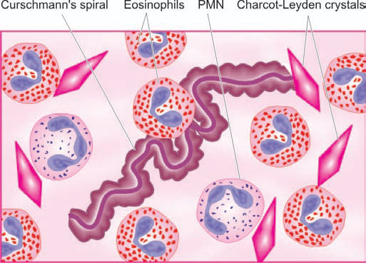
Chronic Obstructive Pulmonary Disease (COPD)
Fig: Diagrammatic appearance of Curschmann’s spiral and Charcot-Leyden crystals found in mucus plugs in patients with bronchial asthma.

Slide 94
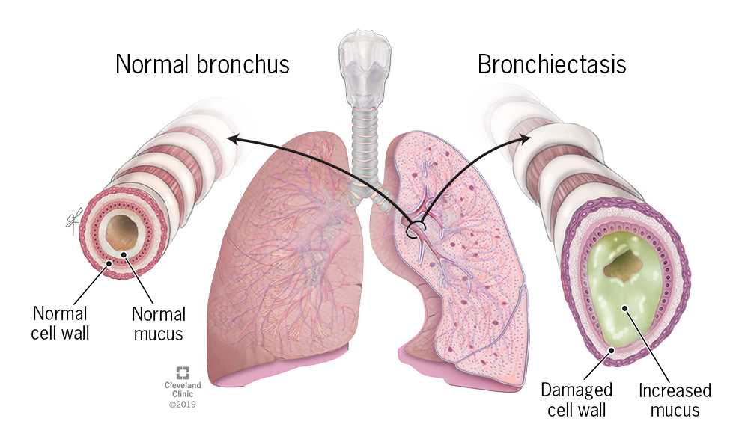
Chronic Obstructive Pulmonary Disease (COPD)
BRONCHIECTASIS:

Slide 95
Chronic Obstructive Pulmonary Disease (COPD)
BRONCHIECTASIS:
It is the abnormal or permanent dilatation of bronchi with chronic productive cough due to chronic necrotizing infection.
Symptoms: Cough, fever, malodorous purulent sputum, dyspnea
Causes:
Bronchial obstruction: foreign body, mucus, tumor, etc.
Necrotizing pneumonias
Cystic fibrosis (affecting mucus-secreting glands)
Gross:
Dilated bronchi and bronchioles extending out to the pleura
Complication:
Abscess, septic emboli, amyloidosis, cor pulmonale (failure or abnormal enlargement of the right side of the heart as a result of disease of the lungs or the pulmonary blood vessels).

Slide 96
Lung collapse/Atelectasis

Slide 97
Lung collapse/Atelectasis
Atelectasis, also known as collapse, is loss of lung volume caused by inadequate expansion of air spaces.
It results in shunting of inadequately oxygenated blood from pulmonary arteries into veins, thus giving rise to a ventilation perfusion imbalance and hypoxia.
Area of collapsed or nonexpanded lung
It may occur due to blockage of a bronchial tube by tumour, foreign body or a plug of mucus which may occur in bronchitis or pneumonia.
Air beyond the blockage is absorbed into the circulation, causing the affected area of lung to collapse.

Slide 98
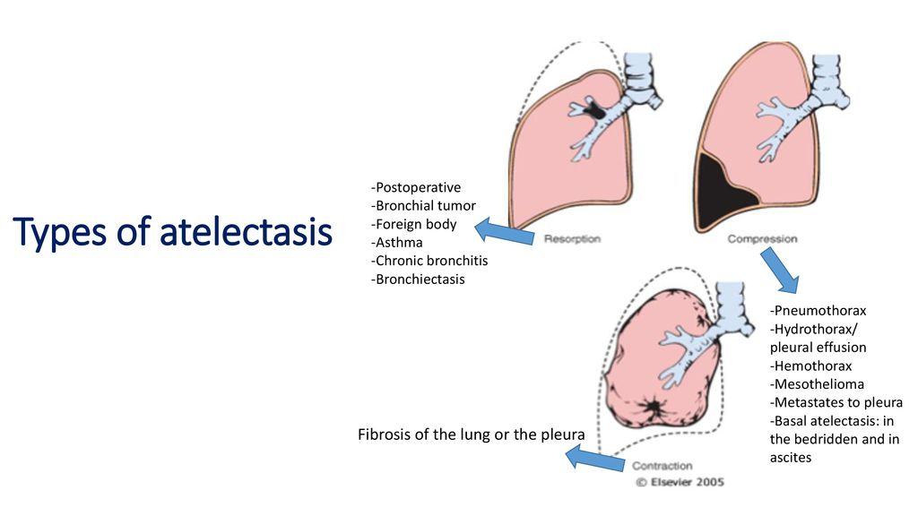
Lung collapse/Atelectasis
Resorption
Compression
Contraction
Fig: Various forms of Lung collapse/Atelectasis

Slide 99
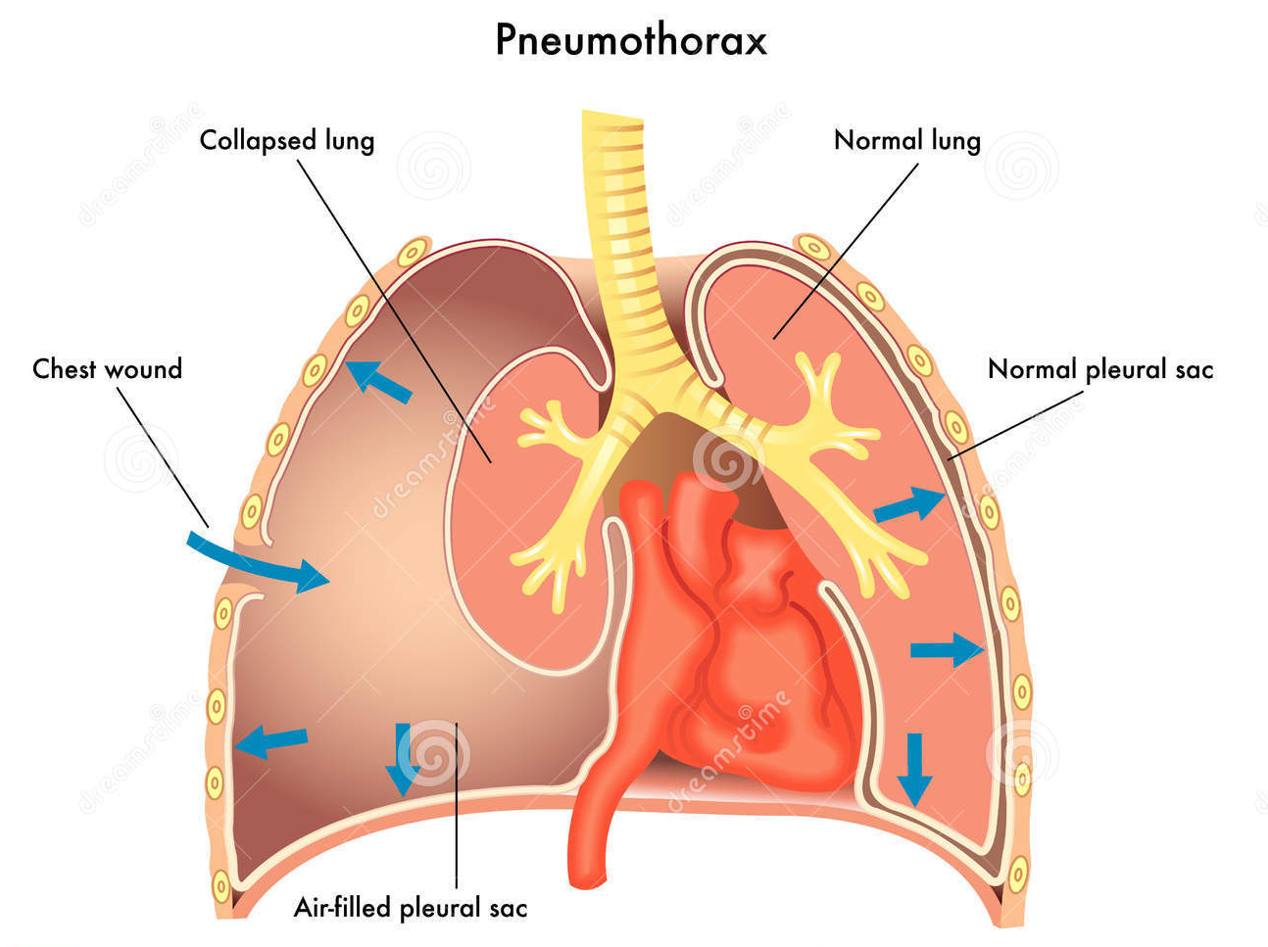
Pneumothorax

Slide 100
Pneumothorax
An accumulation of air in the pleural cavity is called pneumothorax.
It may be:
Spontaneous pneumothorax : occurs due to spontaneous rupture of alveoli in any form of pulmonary disease. Also in association with emphysema, asthma and tuberculosis. Other causes include chronic bronchitis in an old patient, bronchiectasis, pulmonary infarction and bronchial cancer.
Traumatic pneumothorax: caused by trauma to the chest wall or lungs, ruptured esophagus or stomach, and surgical operations of the thorax.
Therapeutic (artificial) pneumothorax: used to be employed formerly in the treatment of chronic pulmonary tuberculosis in which air was introduced into the pleural sac so as to collapse the lung and limit its respiratory movements.

Slide 101
Pleural effusion

Slide 102
Pleural effusion
Pleural effusion means the presence of fluid in the pleural space. The fluid can be either a transudate or an exudate.
When the pleural fluid is a transudate, the condition is termed Hydrothorax.
Haemothorax: Accumulation of pure (whole) blood in the pleural cavity is termed as haemothorax. The most common causes of haemothorax are trauma to the chest wall or to the thoracic viscera and rupture of aortic aneurysm.
Chylothorax: Chylothorax is an uncommon condition in which there is accumulation of milky fluid of lymphatic origin into the pleural cavity. It results most commonly from rupture of the thoracic duct by trauma or obstruction of the thoracic duct such as by malignant tumours, most often malignant lymphomas.

Slide 103
Lung Tumors

Slide 104
Lung Tumors
A number of benign and malignant tumours occur in the lungs but the primary lung cancer, commonly termed bronchogenic carcinoma, is the most common (95% of all primary lung tumours).
The lung is also the commonest site for metastasis from carcinomas (epithelial origin )and sarcomas (mesenchymal tumors/connective tissues origin).
The most common benign tumor is a spherical, small (3 to 4 cm), discrete “hamartoma” (outgrowth of mature tissue; smooth muscle and connective tissue origin) that often shows up as a so-called coin lesion on chest radiographs.
It consists mainly of mature cartilage, but this is often admixed with fat, fibrous tissue, and blood vessels in various proportions.

Slide 105
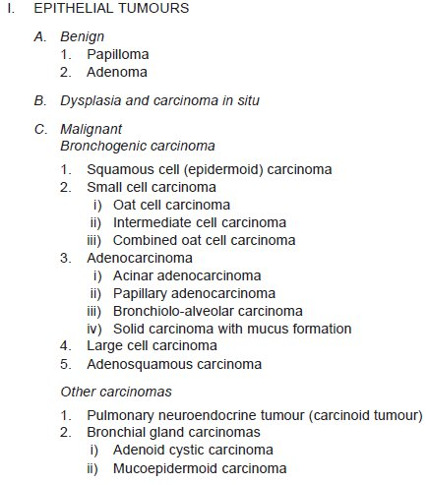
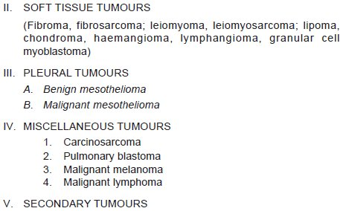
Lung Tumors
TABLE: WHO Classification of Lung Tumours.

Slide 106
BRONCHOGENIC CARCINOMA
The term bronchogenic carcinoma is commonly used for cancer of the lungs which includes carcinomas arising from the respiratory epithelium lining the bronchi, bronchioles and alveoli.
INCIDENCE
Lung cancer is the most common primary malignant tumour in men and accounts for nearly 30% of all cancer deaths in both sexes in developing countries.
Cancer of the lung is a disease of middle and late life with peak incidence in 55-65 years of age, after which there is gradual fall in its incidence.

Slide 107
ETIOLOGY
The high incidence of lung cancer is associated with a number of etiologic factors, most important of which is cigarette smoking.
Smoking
The most important factor for high incidence of all forms of bronchogenic carcinoma is tobacco smoking. About 80% of the lung cancer occurs in active smokers. A number of evidences support the positive relationship of lung cancer with tobacco smoking:
Total dose:
There is a direct statistical correlation between death rate from lung cancer and the total amount of cigarettes smoked e.g.
An average regular smoker has 10 times greater risk of developing lung cancer than a non-smoker.
The risk of smokers of more than 2 packs (40 cigarettes) per day for 20 years is 60-70 times greater than a non-smoker.
Cessation of smoking by a regular smoker results in gradual decline in the chances of developing lung cancer.
After 10 years of abstinence from smoking, the risk declines but never returns to the non-smoker level.

Slide 108
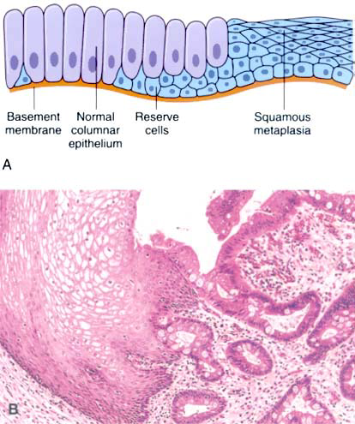
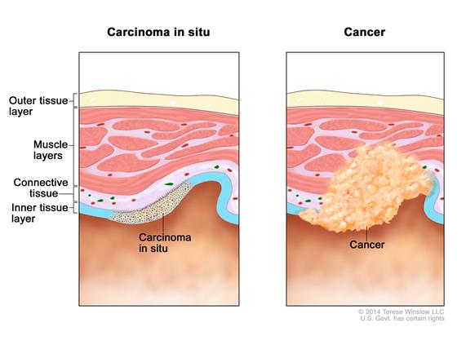
ii) Histologic alterations:
The association of tobacco smoking is strongest for squamous cell carcinoma and small cell carcinoma of the lung.
More than 90% of smokers have sequential epithelial changes in respiratory tract in the form of squamous metaplasia, dysplasia and carcinoma in Situ.
Fig 1. : Metaplasia of normal columnar (left) to squamous epithelium (right), shown schematically
Fig 2. Carcinoma in situ and cancer.

Slide 109
iii) Mechanism:
How tobacco smoking causes lung cancer is not quite clear. However, following facts have been Observed:
Analysis of the tar from cigarette smoke has revealed a number of known carcinogens (e.g. polycyclic aromatic hydrocarbons, nitrosamines) and tumour promoters.
2. Other factors.
Atmospheric pollutions: industrialised and smoky cities
Occupational causes:
asbestos (a soft greyish-white fibrous silicate mineral (material) that does not burn, asbestosis: a lung disease resulting from the inhalation of asbestos particles, marked by severe fibrosis and a high risk of mesothelioma (cancer of the pleura).
Radiation of all types, bis-ethers, nickel, beryllium, arsenic, metallic iron, iron-oxide, uranium mines
Dietary factors: vitamin A deficiency (maintenance of soft mucous tissue).
Chronic scarring: chronic scarring caused by chronic inflammatory changes, old tuberculosis, asbestosis, chronic interstitial fibrosis, old infarcts and in scleroderma.

Slide 110
MOLECULAR PATHOGENESIS
Molecular studies have revealed that there are several genetic alterations in cancer stem cells which produce clones of malignant cells to form tumour mass.
Activation of growth-promoting oncogenes: Mutation in K-RAS oncogene, EGFR oncogene.
Inactivation of tumour-suppressor genes: inactivation of p53 and Rb gene.
Autocrine growth factors: initiator carcinogen causing mutation, followed by action of tumour promoters.
Nicotine acts as both initiator as well as promoter carcinogen. Expresses nicotine acetylcholine receptors which activate the signaling pathway in tumour, blocking the apoptosis.

Slide 111
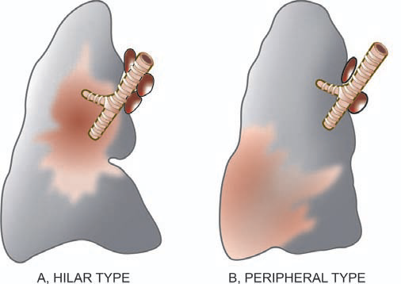
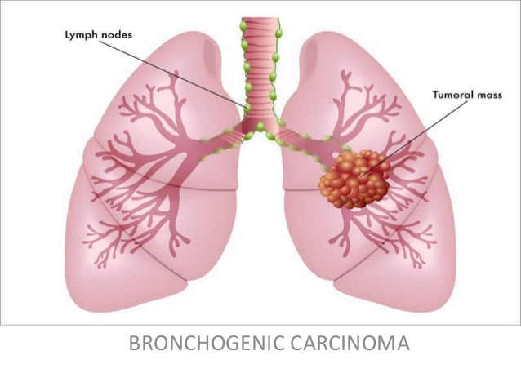
MORPHOLOGIC FEATURES:
Bronchogenic carcinoma can occur anywhere in the lung but the most common location is hilar, followed in descending frequency by peripheral type.
Fig: The two main gross patterns of bronchogenic carcinoma.

Slide 112
Hilar type:
Most commonly, the lung cancer arises in the main bronchus or one of its segmental branches in the hilar parts of the lung, more often on the right side
Small roughened area on the bronchial mucosa
As the tumour enlarges, it thickens the bronchial mucosa producing nodular or ulcerated surface
Spherical mass, 1 to 5 cm in diameter, narrowing and occluding the lumen
The cut surface of the tumour is yellowish-white with foci of necrosis and haemorrhages which may produce cavitary lesions
May lead to bronchogenic carcinoma of lung such as bronchopneumonia, abscess formation and bronchiectasis
The tumour soon spreads within the lungs by direct extension or by lymphatics, and to distant sites by lymphatic or haematogenous routes

Slide 113
Peripheral type:
A small proportion of lung cancers, chiefly adenocarcinomas (derived from epithelium i.e. surface tissue, and carcinomas from glandular tissue) including bronchioloalveolar carcinomas, originate from a small peripheral bronchiole
The tumour may be a single nodule or multiple nodules in the periphery of the lung producing pneumonia-like consolidation of a large part of the lung.
The cut surface of the tumour is greyish and mucoid.

Slide 114
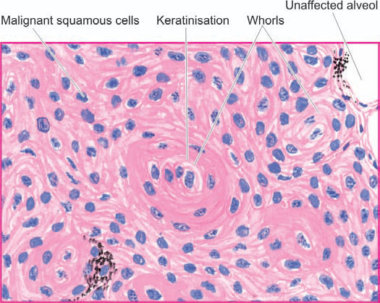
Bronchogenic carcinoma:
Squamous cell (epidermoid) carcinoma:
Most common histologic subtype of bronchogenic carcinoma
These tumours usually arise in a large bronchus and are prone to massive necrosis and cavitation.
The tumour is diagnosed microscopically by identification of either intercellular bridges or keratinisation.
Fig: Squamous cell carcinoma of the lung. Islands of invading malignant squamous cells are seen. A few well-developed cell nests with keratinisation are evident.

Slide 115
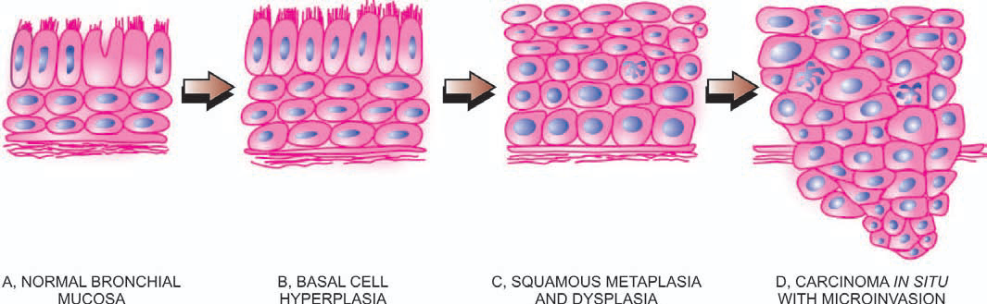
Bronchogenic carcinoma:
Squamous cell (epidermoid) carcinoma:
Fig: Schematic representation of sequential development of squamous cell carcinoma of the lung.

Slide 116
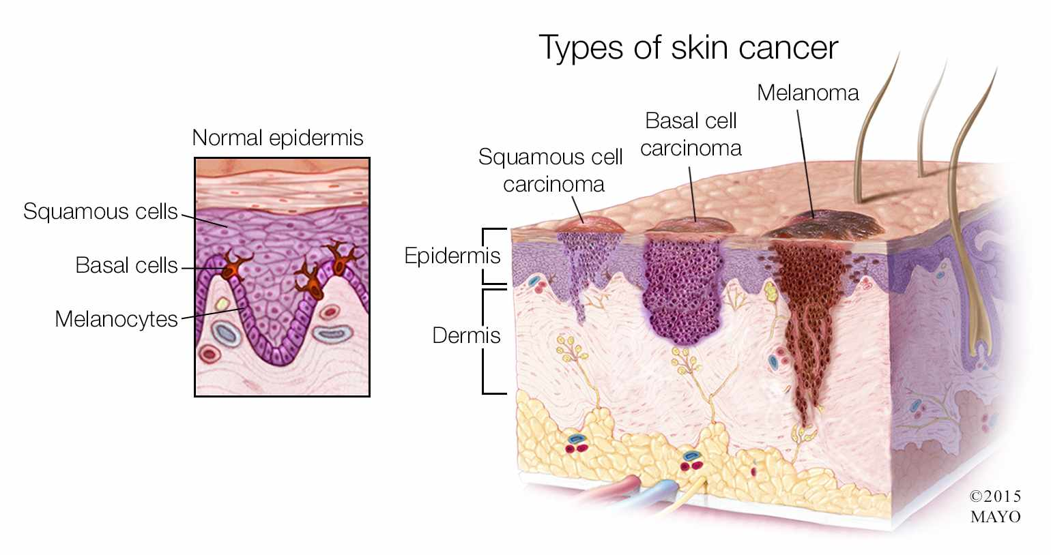
Bronchogenic carcinoma:
Squamous cell (epidermoid) carcinoma:
Squamous cell
Melanocytes
Basal cells

Slide 117
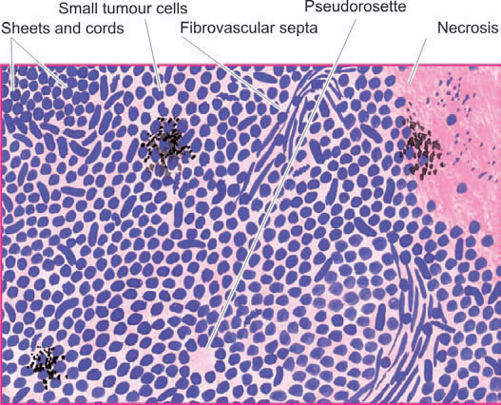
Small cell carcinoma (oat cell carcinoma):
Small cell carcinomas are frequently hilar or central in location, have strong relationship to cigarette smoking and are highly malignant tumours.
The cell is small and either oval or round. These cells are organised into cords, aggregates and ribbons or around small blood vessels forming pseudorosettes. The nucleus stains darkly and the cytoplasm is sparse and difficult to identify.
Fig: Small Oat cell carcinoma of the lung. The tumour cells are arranged in sheets, cords or aggregates and at places form pseudorosettes. The individual tumour cells are small, uniform, lymphocyte-like with scanty cytoplasm.

Slide 118
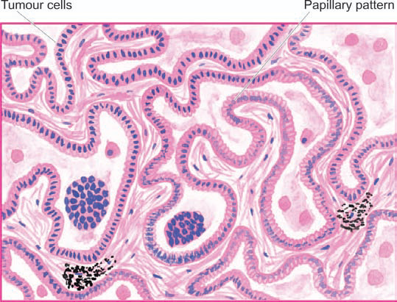
Adenocarcinoma:
Adenocarcinoma, also called peripheral carcinoma due to its location and scar carcinoma due to its association with areas of chronic scarring, is the most common bronchogenic carcinoma in women and is slow-growing.
Characterised by cuboidal to tall columnar and mucus-secreting epithelial cells growing along the existing alveoli and forming numerous papillary structures
Fig: Adenocarcinoma. The alveolar walls are lined by cuboidal to tall columnar and mucin-secreting tumour cells with papillary growth pattern.

Slide 119
Large cell carcinoma:
More common in men, have strong association with cigarette smoking and are highly malignant tumours.
The tumour cells have large nuclei, prominent nucleoli, abundant cytoplasm and well-defined cell borders.
Include giant cell carcinoma with prominence of highly pleomorphic multinucleate cells and clear cell carcinoma composed of cells with clear or foamy cytoplasm without mucin.
Adenosquamous carcinoma:
These are a small proportion of peripheral scar carcinomas having clear evidence of both keratinisation and glandular differentiation.
SPREAD:
Bronchogenic carcinoma can invade the adjoining structures directly, or may spread by lymphatic and haematogenous routes.

Slide 120
CLINICAL FEATURES
Local symptoms: Most common local complaints are cough, chest pain, dyspnea and haemoptysis.
Bronchial obstructive symptoms: Occlusion of a bronchus may result in bronchopneumonia, lung abscess and bronchiectasis in the lung tissue distal to the site of obstruction and cause their attendant symptoms like fever, productive cough, pleural effusion and weight loss.
Symptoms due to metastases: Distant spread may produce varying features and sometimes these are the first manifestation of lung cancer. These include: superior vena caval syndrome, painful bony lesions, paralysis of recurrent nerve and other neurologic manifestations resulting from brain metastases.
Paraneoplastic syndromes: Paraneoplastic syndromes (PNS) are a group of conditions developing in patients with advanced cancer. E.g., Endocrine syndrome, neuromuscular syndromes, osseous, joint and soft tissue, haematologic syndromes, gastrointestinal syndromes, renal syndromes, etc.
Diagnostic aids include radiologic examination and CT scan of the chest, cytologic examination of the sputum, bronchial washings and bronchioalveolar lavage.
Notes:
A paraneoplastic syndrome is a syndrome (a set of signs and symptoms) that is the consequence of cancer in the body, specifically due to the production of chemical signalling molecules (such as hormones or cytokines) by tumor cells or by an immune response against the tumor.

Slide 121
TUMOURS OF PLEURA
Pleural tumours may be primary or secondary. The only important primary tumour of pleura is mesothelioma.
MESOTHELIOMA
Mesothelioma is an uncommon tumour arising from mesothelial lining of serous cavities, most often in pleural cavity, and rarely in peritoneal cavity and pericardial sac.
Mesotheliomas are of 2 types—benign (solitary) and malignant(diffuse).
The biologic behaviour of pleural mesotheliomas is usually predicted by their gross appearance—those forming solitary, discrete masses are generally benign, whereas those which grow diffusely are usually malignant

Slide 122
Benign (Solitary) Mesothelioma:
Benign or solitary mesothelioma is also called as pleural fibroma.
Grossly, it consists of a solitary, circumscribed, small, firm mass, generally less than 3 cm in diameter. Cut surface shows whorls of dense fibrous tissue.
Microscopically, the tumour is predominantly composed of whorls of collagen fibres and reticulin with scatter fibroblasts.

Slide 123
Malignant (Diffuse) Mesothelioma:
Rare but highly malignant tumour associated with high mortality.
Mostly due to exposure to asbestos (particularly crocidolite), a occupational exposure
Asbestos is capable of inducing oncogenic mutation in the mesothelium.
Combination of cigarette smoking and asbestos exposure greatly increases risk to develop bronchogenic carcinoma.
Grossly, the tumour is characteristically diffuse, forming a thick, white, fleshy coating over the parietal and visceral surfaces

Slide 124
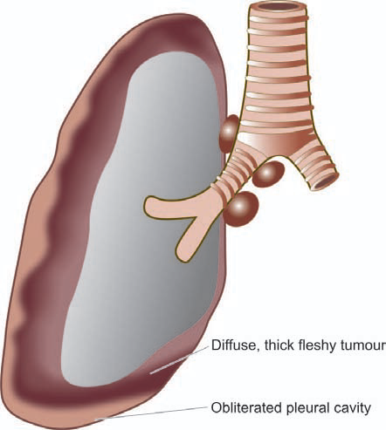
Fig: Malignant (diffuse) mesothelioma, gross appearance. The tumour is seen to form a thick, white, fleshy coat over the parietal and visceral surfaces.

Slide 125
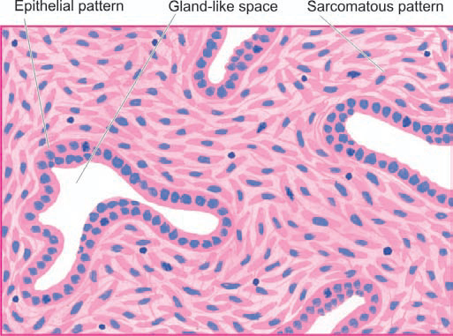
Microscopically,
Malignant mesothelioma may have epithelial, sarcomatoid or biphasic patterns.
Epithelial pattern resembles an adenocarcinoma, consisting of tubular and tubulo-papillary formations. The tumour cells are usually well-differentiated, cuboidal, flattened or columnar cells.
Sarcomatoid pattern consists of spindle cell sarcoma resembling fibrosarcoma. The tumour cells are arranged in a storiform pattern with abundant collagen between them.
Biphasic pattern shows mixed growth having epithelial as well as sarcomatoid pattern. Usually, there are slit-like or gland-like spaces lined by neoplastic mesothelial cells separated by proliferating spindle shaped tumour cells.
Fig: Malignant mesothelioma, showing biphasic pattern of growth.

Slide 126
The End
Thank you for your kind attention..!!

